Slide 1
GENERATIONS OF COMMUNICATION
SAHIL SINHA
A45605221020

Slide 2
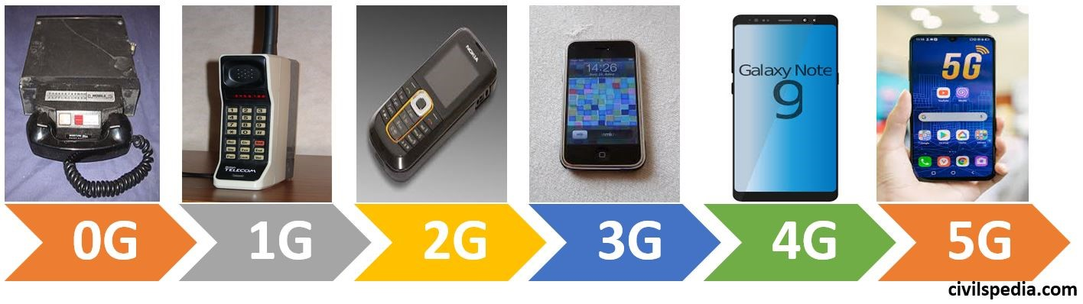

Slide 3
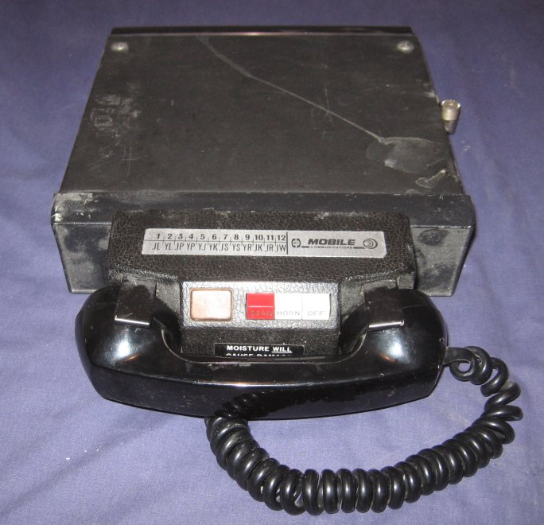
Zeroth Generation (0G) Technology
Pre-cell phone mobile telephone technology.
Uses analog signal.
Communication was possible through voice only.
These mobile telephones were usually mounted in
cars or trucks.

Slide 4
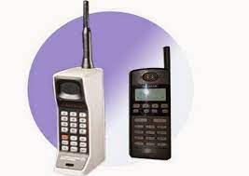
First Generation (1G) Technology
First generation of wireless mobile communication.
Uses analog signals
Through this network the voice call gets modulated to a higher frequency.
This was done with the help of Frequency Division Multiple Access(FDMA).
Coverage area was small.
Speed-2.4kbps

Slide 5
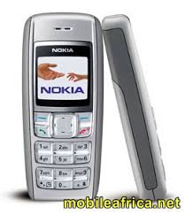
Second Generation (2G) Technology
Uses Digital Signal.
Support Voice and SMS both.
Provide large coverage area.
All phone conversations were digitally encrypted.
Speed-64kbps
When GPRS technology was introduced, it enabled web browsing, e-mail services and fast upload/download speeds. 2G with GPRS is also referred as 2.5G, a step short of next mobile generation.

Slide 6
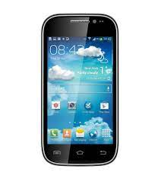
Third Generation (3G) Technology
Data speeds of 144 kbps to 2 Mbps.
High speed web browsing.
Fast and easy transfer of audio and video files.
Uses packet switching.
Expensive mobile phones
High infrastructure costs like licensing fees and mobile towers.
3D Gaming.

Slide 7
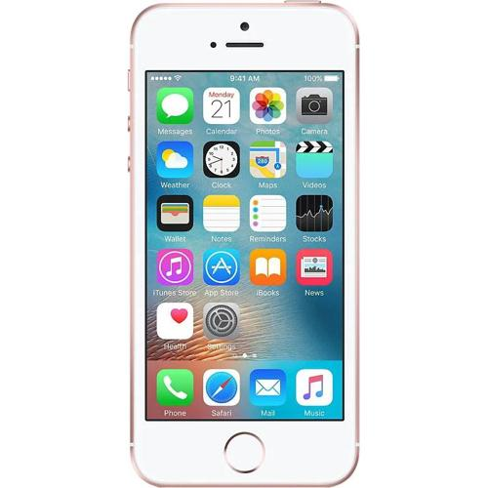
Fourth Generation (4G) Technology
Speeds of 100 Mbps to 1 Gbps.
HD Quality Streaming.
In 4G mobile system, each terminal is assigned a
home agent, which has permanent home IP address.
Uses packet switching technology.
LTE (Long term evaluation ) was mainly for internet.
Vo-LTE (Voice over LTE) is for both voice and the internet..

Slide 8
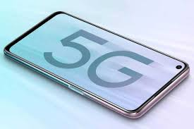
Fifth Generation (5G) Technology
Higher data rates.
Connectivity will be more fast and secure.
Data latency reduces.
30 times faster than 4G.
Uses packet switching.

Slide 9
THANK YOU

